Slide 1









End-to-End Customer Churn Prediction System
Harnessing AI to proactively retain customers and drive business growth.
Team Panda_UGC
Cluster 3, Batch 7
3 Dedicated Members
Nitin Raj, Nishant Kumar, Nitish Kumar

Slide 2

The Churn Challenge
Customer churn is the silent killer of business growth, eroding revenue and customer loyalty. Proactive prediction is key to retention.
What is Churn?
Why it Matters
When a customer discontinues their service or stops doing business with a company. It's a critical metric in subscription-based models.
Significant revenue loss
Higher acquisition costs than retention
Negative impact on brand reputation
Loss of valuable customer feedback

Slide 3




Our AI-Powered Solution
We've developed a comprehensive, end-to-end AI system to predict customer churn, providing actionable insights before it's too late.
ML Model
Backend API
Predicts churn probability
FastAPI driven insights
Frontend Dashboard
Fully Deployed
React + Tailwind CSS
Seamless integration

Slide 4
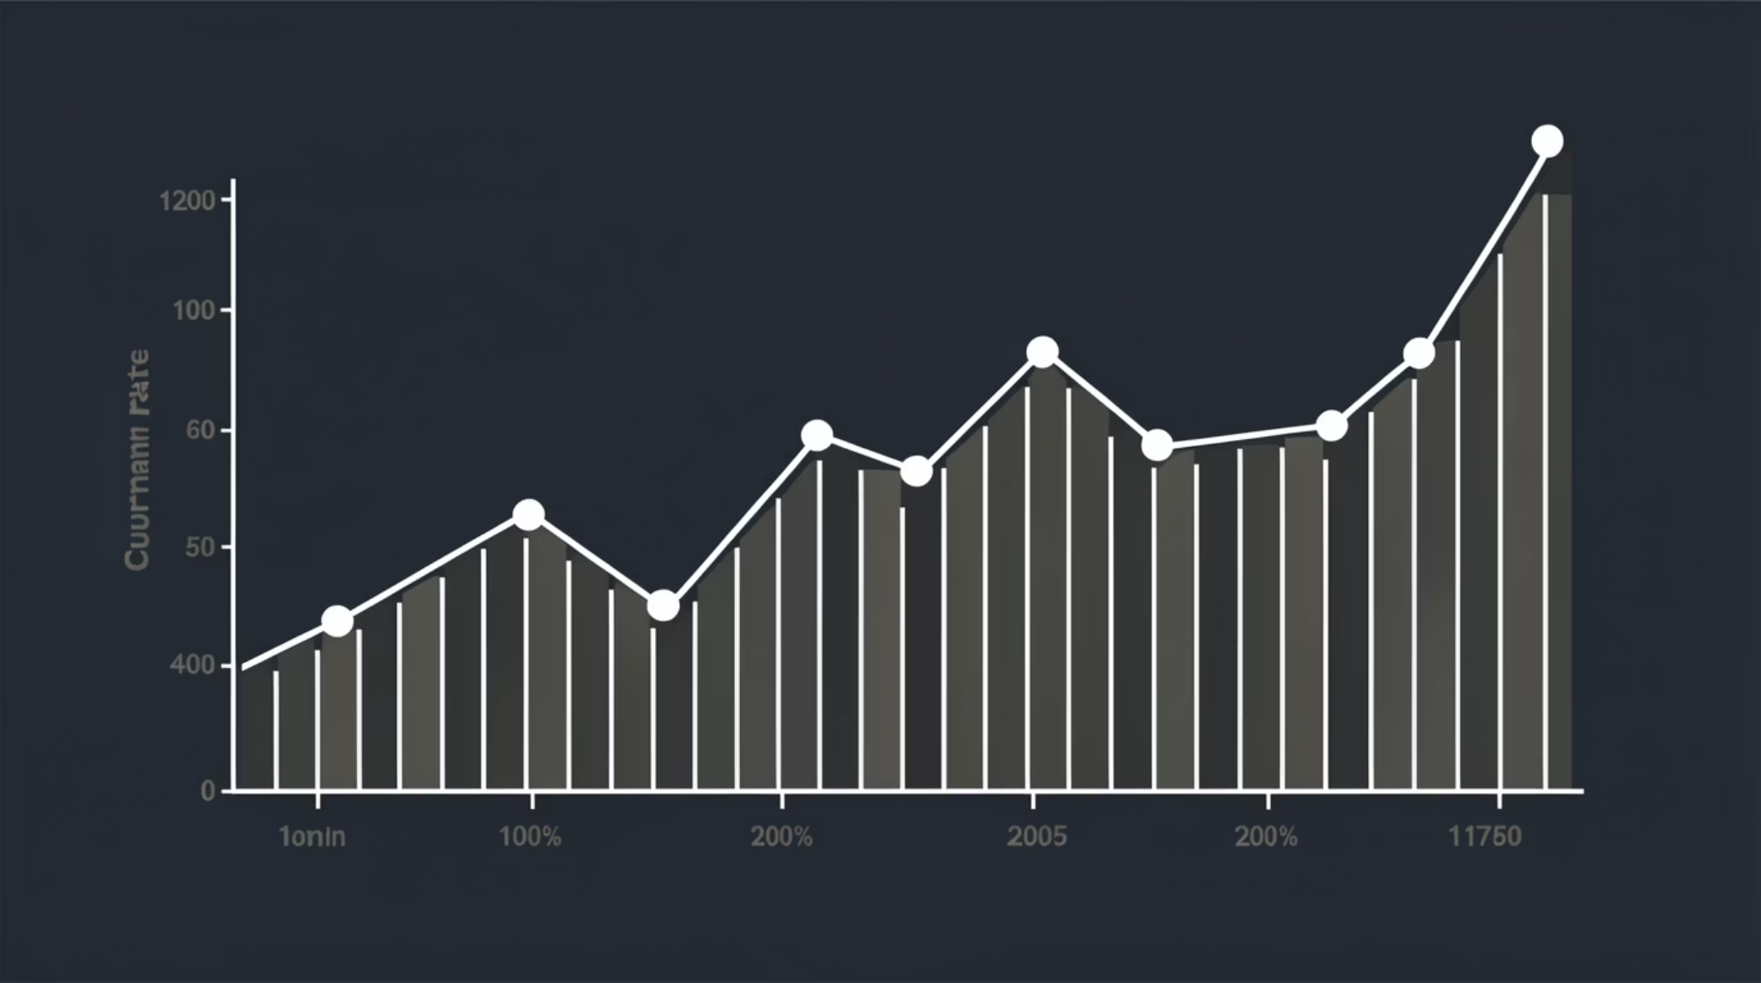
The Foundation: Telco Churn Dataset
Our predictive model is built upon the rich Telco Customer Churn Dataset, providing a realistic basis for analysis.
Target Variable: Churn
A binary indicator (Yes/No) representing whether the customer has churned. This is what our model aims to predict.
Key Features Analysed
Tenure Months: Duration of customer's service
Monthly Charges: Current recurring billing amount
Total Charges: Cumulative charges over tenure
Contract Type: Month-to-month, one year, two year
Internet Service: DSL, Fibre optic, No internet service

Slide 5
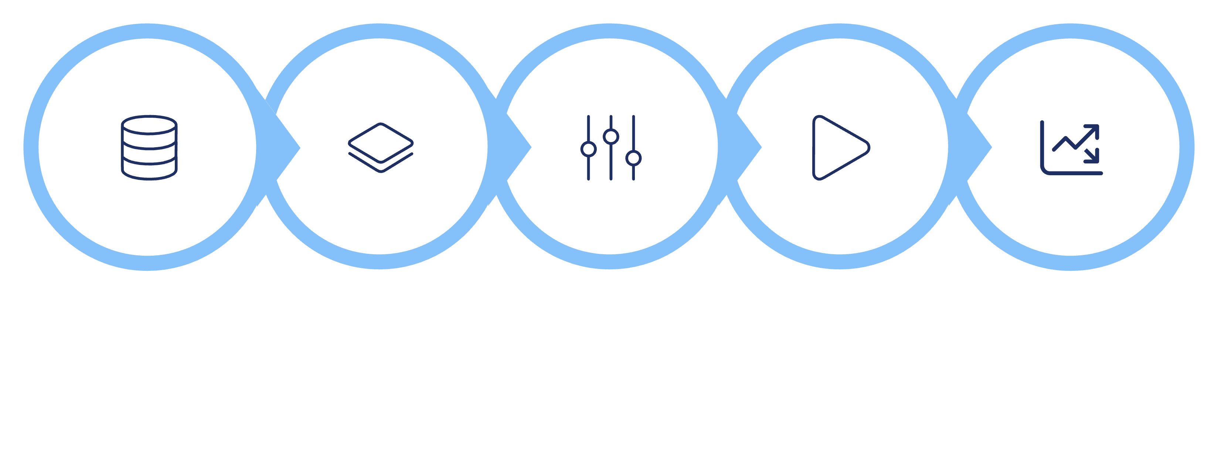





Machine Learning Pipeline
A robust pipeline ensures data integrity, optimal feature representation, and accurate churn probability predictions.
Data
Features
Encode
Train
Evaluate
Algorithm: Random Forest Classifier for robust predictions.
Performance: Achieved an impressive ROC-AUC Score of 0.85.
Refinement: Threshold tuning implemented to effectively handle imbalanced churn data.

Slide 6

Backend Architecture: FastAPI
Our high-performance backend, built with FastAPI, provides a lightning-fast and reliable prediction service.
/predict POST Endpoint
Technical Details
Receives customer data as JSON payload.
Loads our trained ML pipeline (serialized using pickle).
Returns two key metrics:
churn_probability: The likelihood of churn.
churn_label: Categorisation (Low / Medium / High Risk).
CORS Enabled: Ensures seamless frontend-backend communication.
Deployed on Render: Scalable and reliable cloud hosting.
Cold Start Optimisation: Briefly managed for efficient initial response.

Slide 7




Frontend: Intuitive & Responsive UI
A sleek and dynamic dashboard built with React and Tailwind CSS provides users with clear, actionable insights.
Dark Futuristic Design
Interactive Elements
Real-time Status
Dynamic Visualisation
Engaging aesthetic with neon effects and glassmorphism.
Glassmorphism cards and Framer Motion animations for a premium feel.
AI indicators (Idle/Analyzing/Decision Ready) for transparency.
Visual display of churn probability and risk classification (Low/Medium/High).

Slide 8
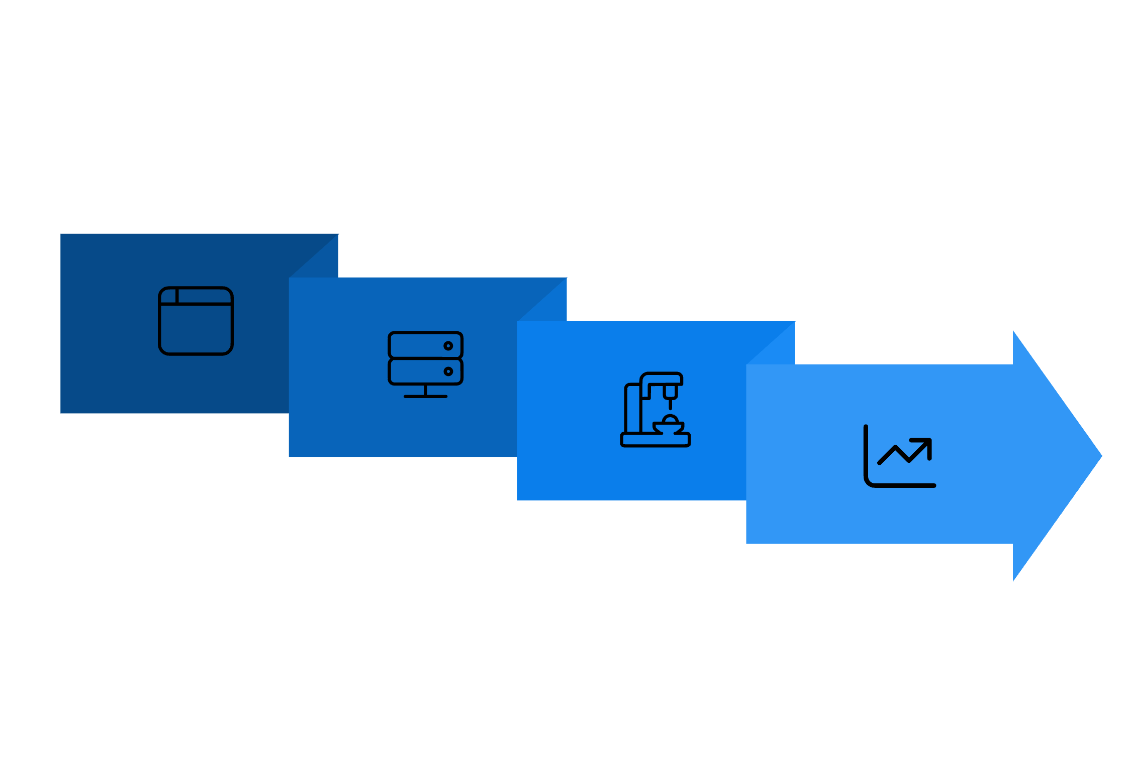




System Architecture Overview
A robust, scalable architecture ensures smooth data flow from user interaction to predictive insights.
Backend API (Render)
Response & Visualization
Frontend (Vercel)
ML Model Processing
This setup provides a highly available and responsive system for real-time churn prediction.

Slide 9

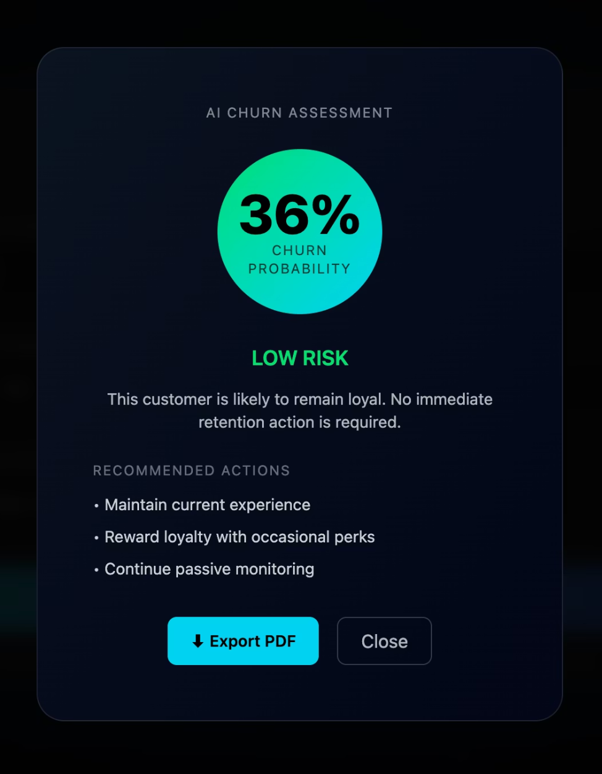
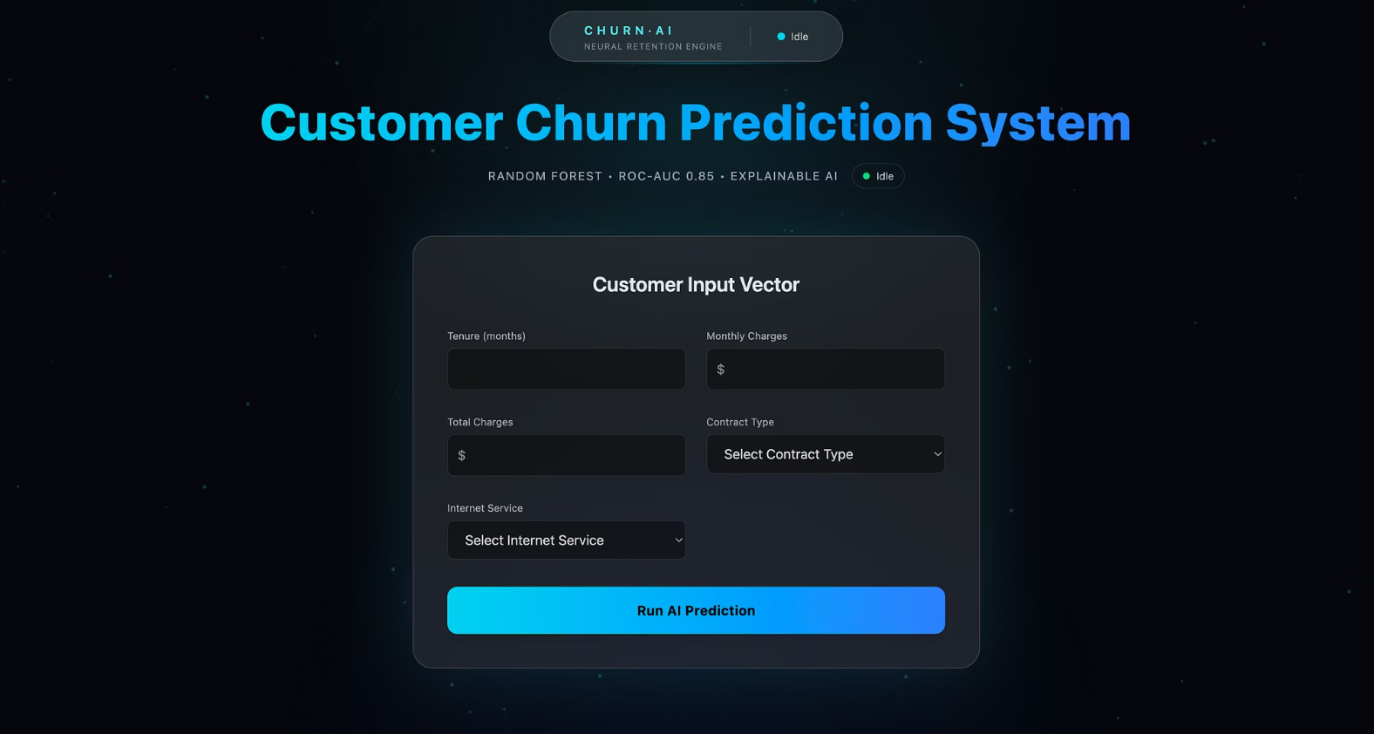
Prediction in Action: Live Output
Experience the system's predictive power with real-time churn analysis and actionable recommendations.
Prediction Output
Customer Input Form
Intuitive form for entering customer data to generate a churn prediction.
For a 36% churn probability, the system classifies it as 'Low Risk' and provides proactive steps to retain the customer.

Slide 10


Key Strengths & Future Vision
Our project showcases strong ML fundamentals, full-stack integration, and significant real-world business impact.
Core Advantages
Future Enhancements
Proactive customer retention strategies.
Minimises revenue loss due to churn.
Scalable and production-ready architecture.
Explainable AI outputs for informed decisions.
SHAP-based feature explanations for deeper insights.
User authentication & Admin dashboard for enterprise use.
Batch prediction capabilities for large datasets.
Seamless CRM integration for automated workflows.

